Slide 1
Spark MLlib
3

Slide 2
Natural Language Processing
Lemmatization and Stop Words
ArrayBuffer(daniel, mccoy, subject, motifbc, organization, line, article, ray, stell, write, install, backward, compatibility, motif, will, motif, client, work, server, work, run, motif, server, motifbc, define, daniel, mccoy, space, nasa, mail, code, tel, space, center, fax, houston, texas, future)

Slide 3
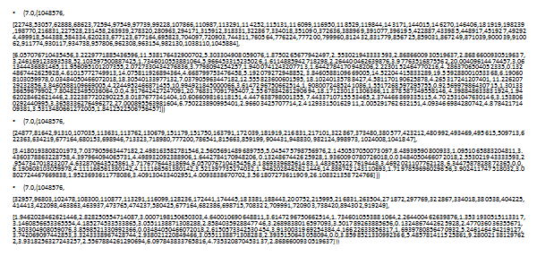
TF-IDF results
Label
Number of features
Hash code for each word in string
TF_IDF Score for corresponding word in previous array

Slide 4
Label and Prediction
Value of prediction label :
(4.0,4.0) ✓
(5.0,4.0) X
(4.0,4.0) ✓
(4.0,4.0) ✓
(4.0,4.0) ✓
(3.0,4.0) X
val predictionAndLabel = X_test.map(x => (model.predict(x.features), x.label) )
val accuracy = 1.0 * predictionAndLabel.filter(x => x._1 == x._2).count() / X_test.count()

Slide 5
MongoDB in Mongo Labs
val jsonHeaders = """{"jsonrpc": "2.0", "method": "someMethod", "params": {"dataIds":["12348" , "456"]}, "data2": "777"}"""
val result = Http("https://api.mongolab.com/api/1/databases/databasename/collections/collectionsname?apiKey=****")
.postData(jsonHeaders)
.header("content-type", "application/json")
.header("X-Application", "myCode")
.header("X-Authentication", "myCode2")
.option(HttpOptions.readTimeout(10000))
.asString

Slide 6
Movie Recommendations

Slide 7
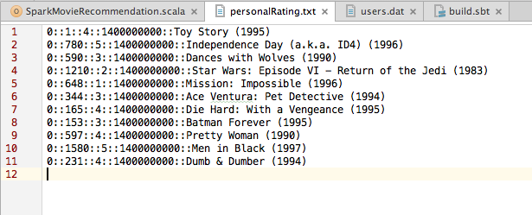
Input
User Id
Movie Id
Rating
Time stamp
Movie Title

Slide 8
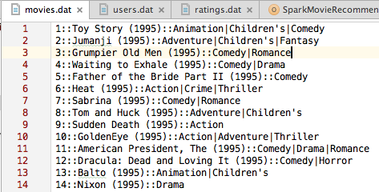
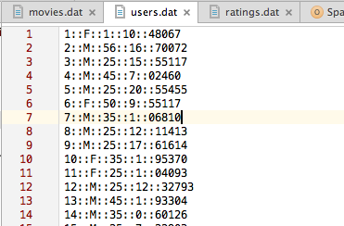
Training Set
MovieLens dataset :
“ratings.dat” and “movies.dat”.
Formats :
“ratings.dat”
UserID::MovieID::Rating::Timestamp
“movies.dat”
MovieID::Title::Genres

Slide 9
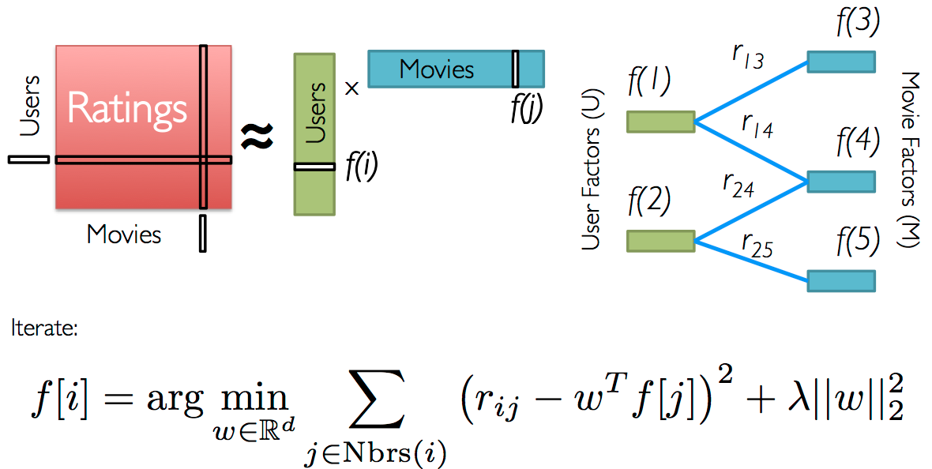
Low-Rank Matrix Factorization

Slide 10
Create Spark Context
val conf = new SparkConf()
.setAppName("MovieLensALS")
.set("spark.executor.memory", "2g").setMaster("local[*]")
val sc = new SparkContext(conf)

Slide 11
Load Files
def loadRatings(path: String): Seq[Rating] = {
val lines = Source.fromFile(path).getLines()
val ratings = lines.map { line =>
val fields = line.split("::")
Rating(fields(0).toInt, fields(1).toInt, fields(2).toDouble)
}.filter(_.rating > 0.0)
if (ratings.isEmpty) {
sys.error("No ratings provided.")
}
else {
ratings.toSeq
}
}

Slide 12
Data Split : Training and Testing
// split ratings into train (60%), validation (20%), and test (20%) based on the
// last digit of the timestamp, add myRatings to train, and cache them
val numPartitions = 4
val training = ratings.filter(x => x._1 < 6)
.values
.union(myRatingsRDD)
.repartition(numPartitions)
.cache()
val validation = ratings.filter(x => x._1 >= 6 && x._1 < 8)
.values
.repartition(numPartitions)
.cache()
val test = ratings.filter(x => x._1 >= 8).values.cache()
val numTraining = training.count()
val numValidation = validation.count()
val numTest = test.count()
println("Training: " + numTraining + ", validation: " + numValidation + ", test: " + numTest)

Slide 13
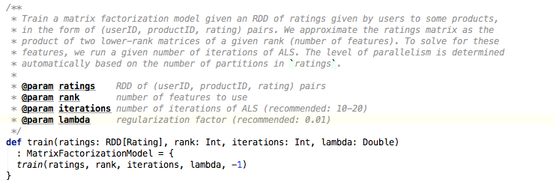
Building the Best Model
// train models and evaluate them on the validation set
for (rank <- ranks; lambda <- lambdas; numIter <- numIters) {
val model = ALS.train(training, rank, numIter, lambda)
val validationRmse = computeRmse(model, validation, numValidation)
println("RMSE (validation) = " + validationRmse + " for the model trained with rank = "
+ rank + ", lambda = " + lambda + ", and numIter = " + numIter + ".")
if (validationRmse < bestValidationRmse) {
bestModel = Some(model)
bestValidationRmse = validationRmse
bestRank = rank
bestLambda = lambda
bestNumIter = numIter
}
}

Slide 14
Creating Test Rate Mean Square Error(RMSE) for Testing
// evaluate the best model on the test set
val testRmse = computeRmse(bestModel.get, test, numTest)
println("The best model was trained with rank = " + bestRank + " and lambda = " + bestLambda
+ ", and numIter = " + bestNumIter + ", and its RMSE on the test set is " + testRmse + ".")
// create a naive baseline and compare it with the best model
val meanRating = training.union(validation).map(_.rating).mean
val baselineRmse =
math.sqrt(test.map(x => (meanRating - x.rating) * (meanRating - x.rating)).mean)
val improvement = (baselineRmse - testRmse) / baselineRmse * 100
println("The best model improves the baseline by " + "%1.2f".format(improvement) + "%.")

Slide 15
Recommendations
// make personalized recommendations
val myRatedMovieIds = myRatings.map(_.product).toSet
val candidates = sc.parallelize(movies.keys.filter(!myRatedMovieIds.contains(_)).toSeq)
val recommendations = bestModel.get
.predict(candidates.map((0, _)))
.collect()
.sortBy(-_.rating)
.take(10)
var i = 1
println("Movies recommended for you:")
recommendations.foreach { r =>
println("%2d".format(i) + ": " + movies(r.product))
i += 1
}

Slide 16
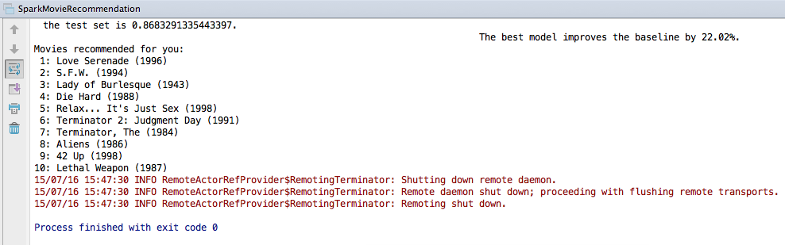
Output

Slide 17
References
Movie Recommendation Reference
http://ampcamp.berkeley.edu/big-data-mini-course/movie-recommendation-with-mllib.html
MLlib Guide
https://spark.apache.org/docs/latest/mllib-guide.html
Spark Configuration
https://spark.apache.org/docs/latest/configuration.html#spark-properties

